Slide 1
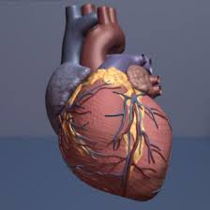
Localization of culprit artery in STEMI
Topic presentation
Speaker
Dr.Suneesh.K Senior Resident, Dept. of Cardiology Calicut Medical College

Slide 2
Overview
Introduction
Coronary circulation and blood supply of the heart
AWMI
IWMI
RVMI
PWMI
Conduction disturbances
Atrial Infarction
Exercises

Slide 3
Introduction
Careful analysis of the surface ECG is highly useful in localizing the culprit vessel and immediate prognostication
Helps in deciding the need for an aggressive reperfusion strategy
ECG correlation of infarct related artery predict moratlity in acute myocardial infarction

Slide 4
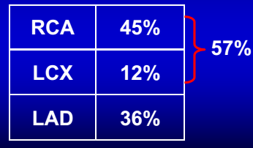
Prevalence of STEMI
Newby et al, GUSTO Study J Am Coll Cardiol1996;27:625-32

Slide 5
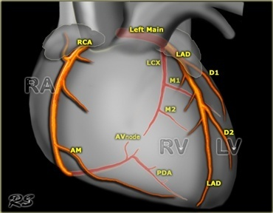
Coronary circulation
Left Main or left coronary artery
LAD
Diagonal braches (D1, D2)
Septal branches
Circumflex
Marginal branches (M1, M2)
Right coronary artery
Conus, sinoatrial branch
RV branch
Acute marginal branch
AV nodal branch
Posterior descending artery (PDA)
Notes:
The two coronary arteries, the right coronary artery (RCA) and left coronary artery (LCA), originate from their respective sinuses of Valsalva—the RCA from the right sinus of Valsalva and the LCA from the left sinus of Valsalva.
The right sinus of Valsalva is located anteriorly and the left sinus of Valsalva posteriorly and to the left. The third sinus of Valsalva, located posteriorly and to the right, does not give rise to a coronary artery, and is referred to as “noncoronary cusp/sinus.”
There may be variations in the number, shape, and location of coronary ostia or origins of the coronary arteries, most of which are of no clinical significance.
The RCA arises from the right sinus of Valsalva, inferior to the origin of the LCA.
It courses anteriorly and inferiorly under the right atrial appendage along the right atrioventricular (AV) groove, toward the acute margin of the heart, where it turns posteriorly and inferiorly toward the crux of the heart and divides into the posterior descending coronary artery (PDA) and the posterolateral ventricular branch (PLB)
The RCA supplies the right atrium, right ventricle, posterior third of the interventricular septum, and sinoatrial and AV nodes.
The conus branch arises as the first branch of the RCA
The conus branch courses anteriorly and to the right and supplies the pulmonary outflow tract
The sinoatrial nodal artery is the second branch that arises from the proximal RCA in 65.4%, immediately distal to the RCA origin. In 16.6% of cases, the sinoatrial nodal artery arises from the LCX
This artery courses toward the superior vena cava near the cranial aspect of the interatrial septum
The next branches of the RCA are the marginal branches that supply the right ventricular myocardium.
The acute marginal artery comes off the acute margin of the heart and courses anteriorly and to the right, anterior to the right ventricle.
The acute marginal branches supply the free wall of the right ventricular myocardium
In 10% to 20% of patients, an acute marginal branch runs on the diaphragmatic surface of the heart to supply the distal posterior interventricular septum.
After the RCA gives off the acute marginal branches, it continues in the right AV groove toward the diaphragmatic aspect of the heart. At the crux of the heart, the RCA makes a U-turn and branches into the PDA and PLB.
The PDA is of variable size and runs along the diaphragmatic surface in the posterior interventricular groove toward the inferior septum. Short septal branches arising perpendicularly from the PDA supply the posterior third of the septum and can connect with the septal branches from the LAD to form a collateral circulation.
The PLB runs in the posterior left AV groove and gives off multiple branches that supply the posterior and inferior wall of the left ventricle.
Within 1 to 2 cm of the crux, the PLB runs on the diaphragmatic surface of the left ventricle parallel to the PDA to supply the posterolateral diaphragmatic surface of the left ventricle. Here the RCA can serve as a collateral for an occluded LCX.
Also close to the crux of the heart, just distal to the PDA origin, the RCA gives rise to a small AV nodal artery that supplies the AV node of the conduction system . The AV nodal artery arises from the LCX in a left dominant system.
The LAD runs anteriorly and inferiorly in the heart, and supplies the anterior and antero-lateral wall of the left ventricular myocardium and the anterior two thirds of the interventricular septo-manterior interventricular groove to the apex of

Slide 6
Blood supply of heart
LAD
Supplies the anterior, lateral, anterior two-thirds of septum, and frequently the inferoapical segments of LV, including the proximal part of bundle branches
RCA
Perfuses SA node (65%), AV node, postero-medial papillary muscle, inferior part of LV, RV, and variably also the posterior and lateral segments

Slide 7
Blood supply of heart (contd..)
Circumflex branch
Posterior wall and variably inferior and lateral segments
Posterior wall involvement → usually underestimated and under treated

Slide 8
Blood supply of heart (contd..)
SA node – RCA in 65%
AV node – RCA in 90%
Bundle of His – Mainly RCA
RBB – LAD
LBB – L Ant branch – LAD
LBB - L Post branch – LAD & PDA

Slide 9
Dominance
Supplies circulation to the inferior wall and inferior portion of the posterior IVS
Dominant artery passes crux and IVS, giving rise to posterolateral branches and PDA
Dominant artery also gives rise to the AV nodal branch
Nondominant artery is usually smaller in size and terminates early in its respective AV groove

Slide 10
Dominance
RCA – 70%
LCX – 10%
Co- dominant – 20%

Slide 11
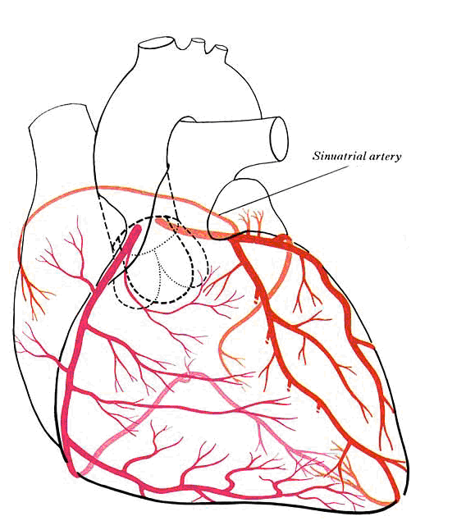
Right dominant

Slide 12
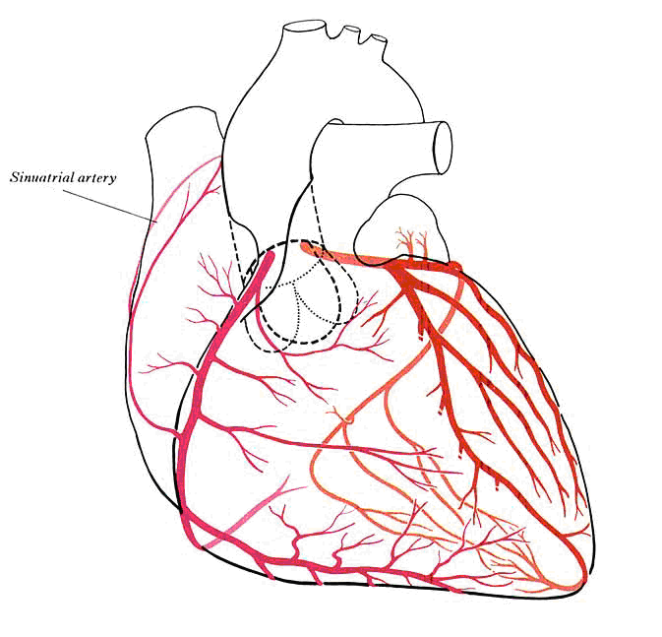
Left dominant

Slide 13
The concept of injury vector: Direct and reciprocal changes
Injury vector is oriented towards the injured area and generates STE in the leads facing the vector’s head
ST-segment depression in the leads facing the vector’s tail (opposed leads)
Leads perpendicular to dominant vector will record an iso-electrical ST segment
Notes:
Therefore, the injury vector direction is determined by the myocardial area at risk, which will be different according to the occluded artery and the site of the occlusion

Slide 14
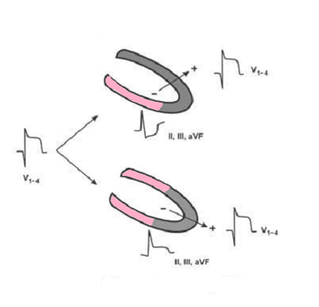
Proximal occlusion of long LAD
Distal occlusion of long LAD
Notes:
When evaluating a patient with STEMI with ST-segment elevation in precordial leads
(V1−2to V4−6),we can strongly suggest that the occluded artery is the LAD. The correlation of the
ST-segment elevation in V1−2to V4−6with the ST morphology in II,III,and aVF allows us to know
if it is an occlusion proximal or distal to D1. If it is proximal,the involved muscular mass in the
anterior wall is large and the injury vector is directed forward and upward,even though there can
be an evident inferior wall compromise if the LADis long. This explains the negativity recorded in
II,III,and aVF since these leads face the tail of the injury vector. On the contrary,when the
involved myocardial mass in the anterior wall is smaller,because it is an occlusion distal toD1,
and the LADis quite long,the injury vector in this U-shaped infarction (inferoanterior) is directed
anteriorly,but somewhat downward,and so it generally produces slight ST-segment elevation in II,
III,and aVF because these leads face the head of the injury vector

Slide 15
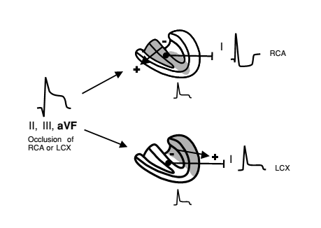
Notes:
In a STEMI with ST-segment elevation present in II,III,and aVF, the study of the ST
elevation and depression in different leads facilitates identification of the occluded artery (RCA or
LCX) and even the site of the occlusion and its anatomical characteristics (dominance,etc). For
example, in this figure we can see that if ST-segment depression exists in lead I, it means that this
lead is facing the tail of the injury vector that is directed to the right,and therefore the occlusion is
located in the RCA. On the contrary,when the occlusion is located in the LCX,lead I faces the
injury vector head,and in this case it is directed somewhat to the left and will be recorded as
ST-segment elevation in lead I. Therefore,checking the ST deviation in lead I may give a clue as to
as to the location of the culprit artery

Slide 16
Ischemia at a distance Vs reciprocal changes
Patients with ST elevation in one territory often have ST depression in other territories
The additional ST deviation may represent acute ischemia due to coronary artery disease in non infarct related arteries (ischemia at a distance) or may represent pure "mirror image" reciprocal changes
Most of the common patterns of remote ST depression probably represent reciprocal changes and not “ischemia at a distance”

Slide 17
AWMI

Slide 18
Anteroseptal zone: occlusion of the LAD and its branches
Proximal to 1st septal and 1st diagonal branch (40%)
Distal to S and D (40%)
Proximal to D1 but distal to S1 (5-10%)
Proximal to S1 but distal to D1 (5-10%)
Selective D1–D2occlusion
Selective S1–S2 occlusion

Slide 19
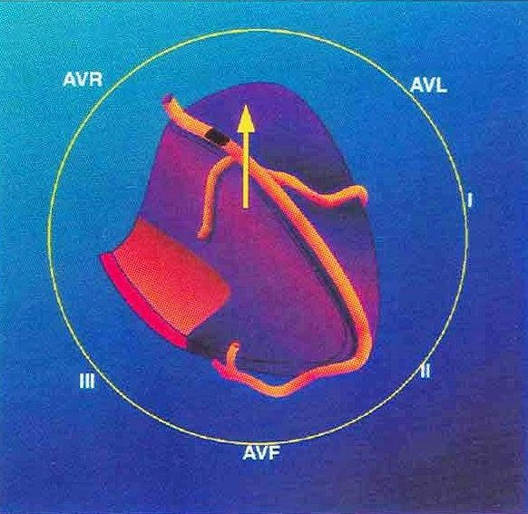
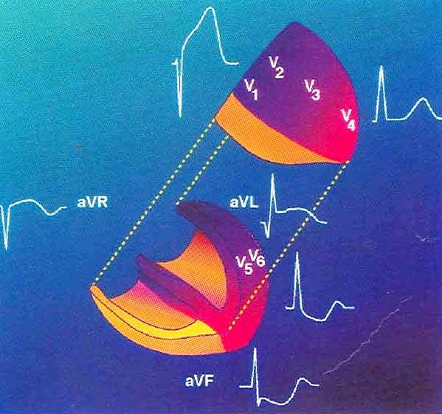
Proximal LAD occlusion (Dominance of Basal area)
Injury vector is directed anteriorly and upward, and somewhat to the right or left
Notes:
In this case, theinjury vectoris directed anteriorly and upward, and somewhat to the right or the left, depending on whether septal–the most frequent–or lateral involvement predominates

Slide 20
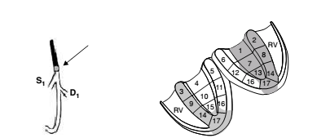
Proximal LAD occlusion (Dominance of Basal area)
Notes:
When the involvement of the anterolateral area is predominant, the ST elevation is also seen in aVL and often in I because the injury vector falls in the positive hemifield of aVL and on the border of positive hemifield of I (around−90◦). The larger the ST-segment elevation in aVL (anterolateral involvement), the lesser the changes in aVR (anteroseptal involvement) and vice versa. ST-segment depression occurs in the inferior leads especially in II and also in V5−6 because the anteroseptal compromise is usually predominant over the anterolateral compromise and the injury vector is directed somewhat to the right and upward

Slide 21
Proximal LAD occlusion (Dominance of Basal area)
STE aVR and STE in V1 > 2.5 mm
ST depression in inferior leads and in V5
Abnormal Q in aVL
ST depression in the inferior wall (III +aVF ≥2.5 mm) is quite suggestive of a proximal occlusion of LAD above D1

Slide 22
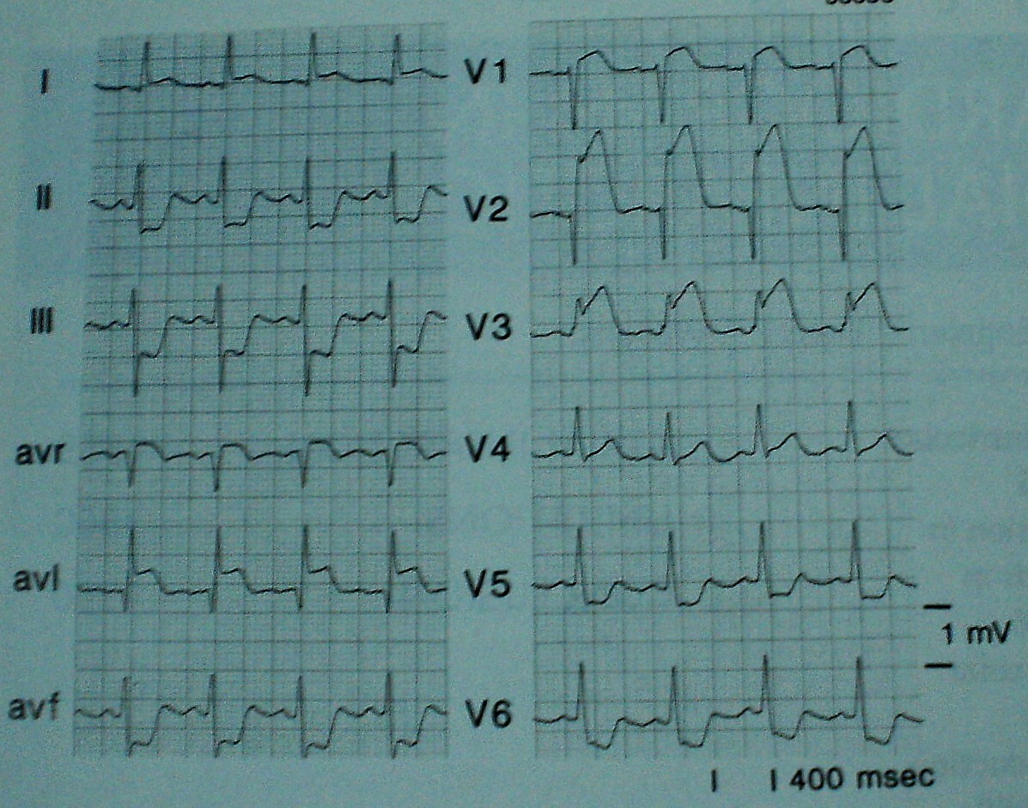

Slide 23
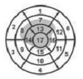
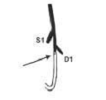
Distal LAD occlusion (Dominance of inferoapical area)

Slide 24
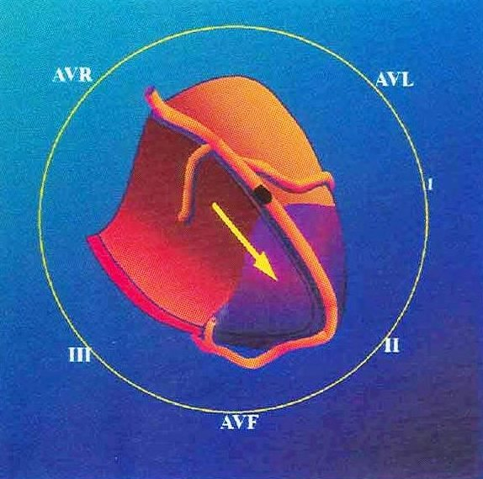
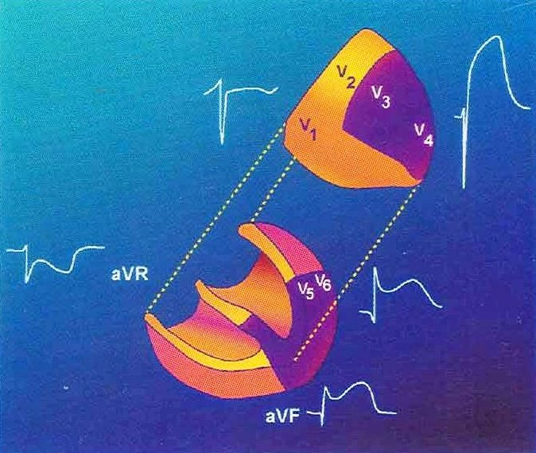
Distal LAD occlusion (Dominance of inferoapical area)

Slide 25
Distal LAD occlusion (Dominance of inferoapical area)
Inferior third of the LV & low-lateral involvement (apical infarction)
Injury vector is directed forward and left, and downward
STE in inferior leads (II > III) in addition to V3-V6
Slight ST-segment depression in aVR
Wide Q V4-V6 some times
STE is seen in the precordial and inferior leads in the presence of a STEMI due to the very proximal occlusion of the RCA
In this case the STE usually is V1>V3−4, while in a STEMI due to the distal occlusion of the LAD the opposite occurs
(i.e., the STE is V1<V3−4)

Slide 26
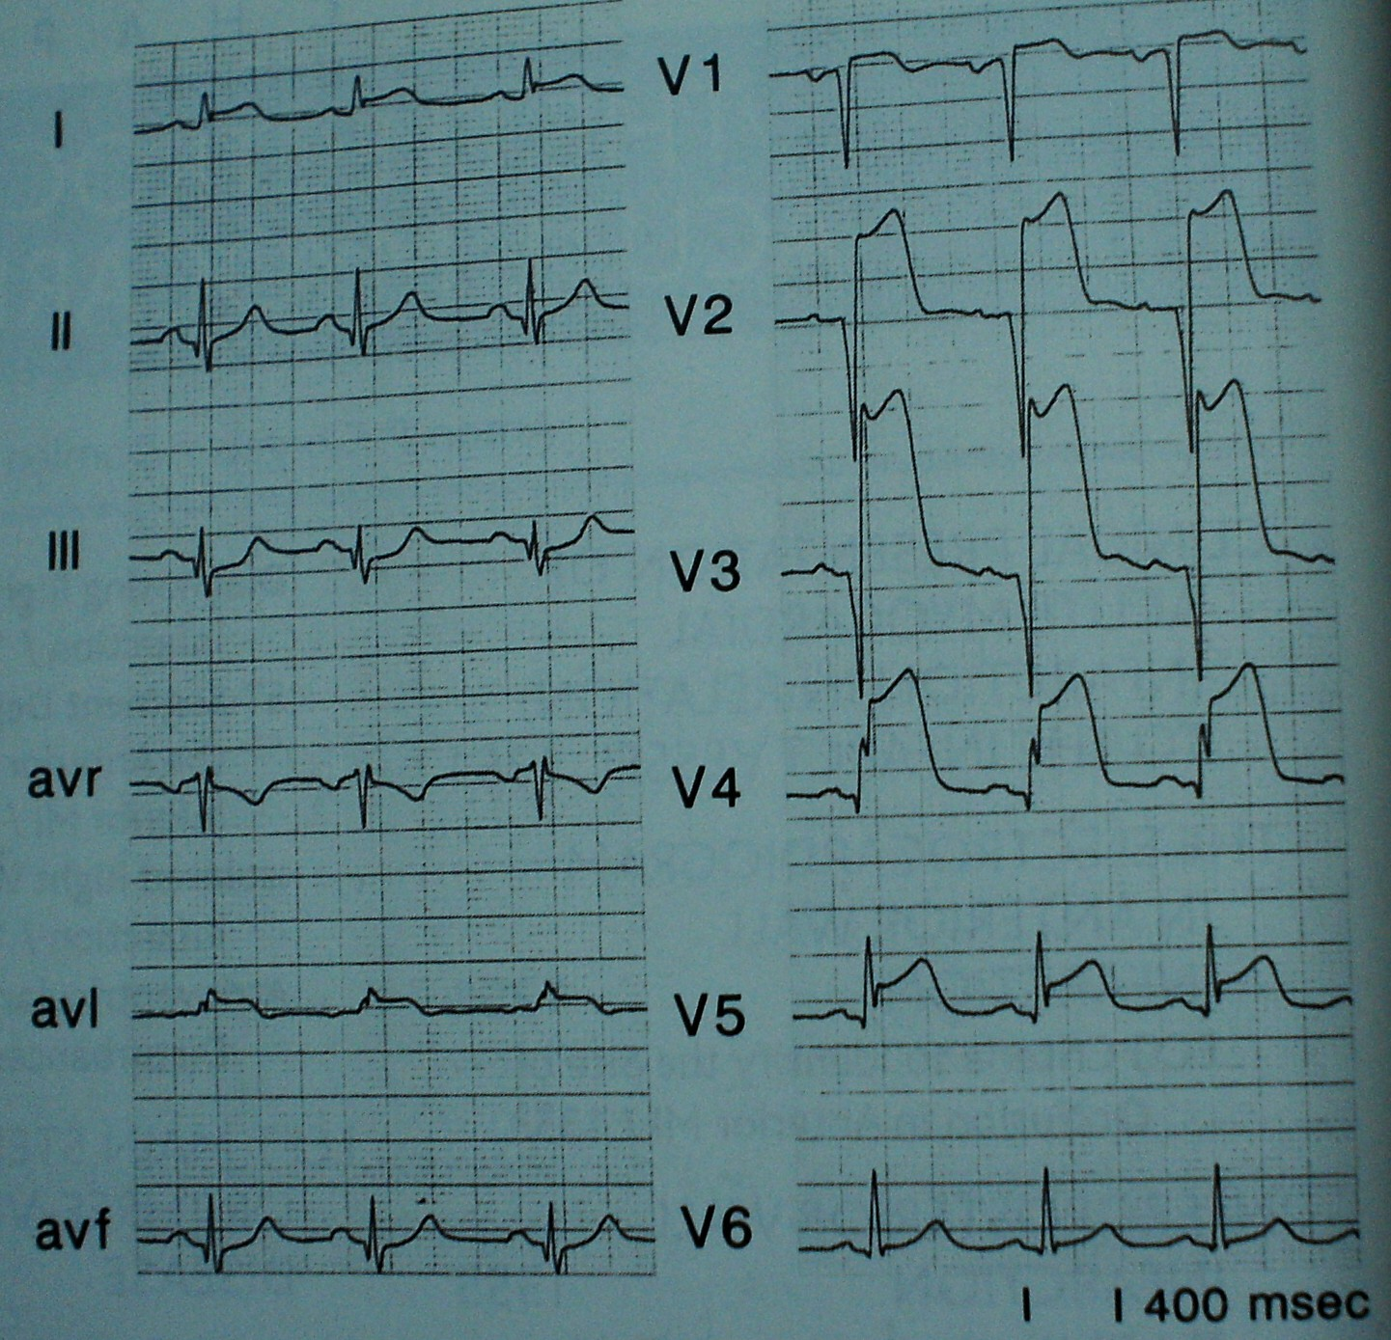

Slide 27
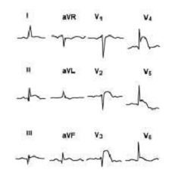
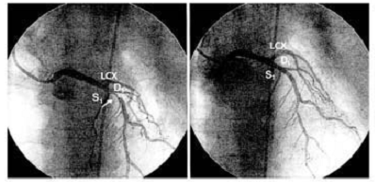

Slide 28
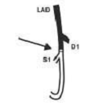
1st Diagonal not involved (Dominance of septal area)-Proximal to S1

Slide 29
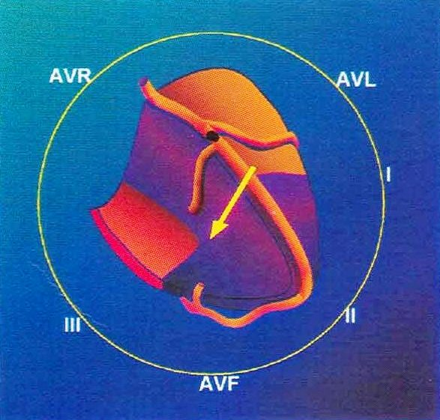
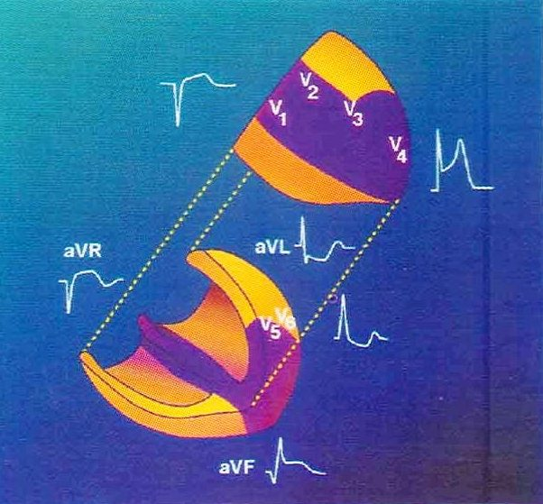
1st Diagonal not involved (Dominance of septal area)-Proximal to S1
Injury vector is directed anteriorly, to the right and sometimes downward

Slide 30
1st Diagonal not involved (Dominance of septal area)-Proximal to S1
Antero-septal infarction
STE in aVR and > 2.5 mm STE in V1
ST elevation from V1to V3−4and II, III, and aVF
ST depression in V6, I and aVL
STE in V3R
RBBB/ QRBBB

Slide 31
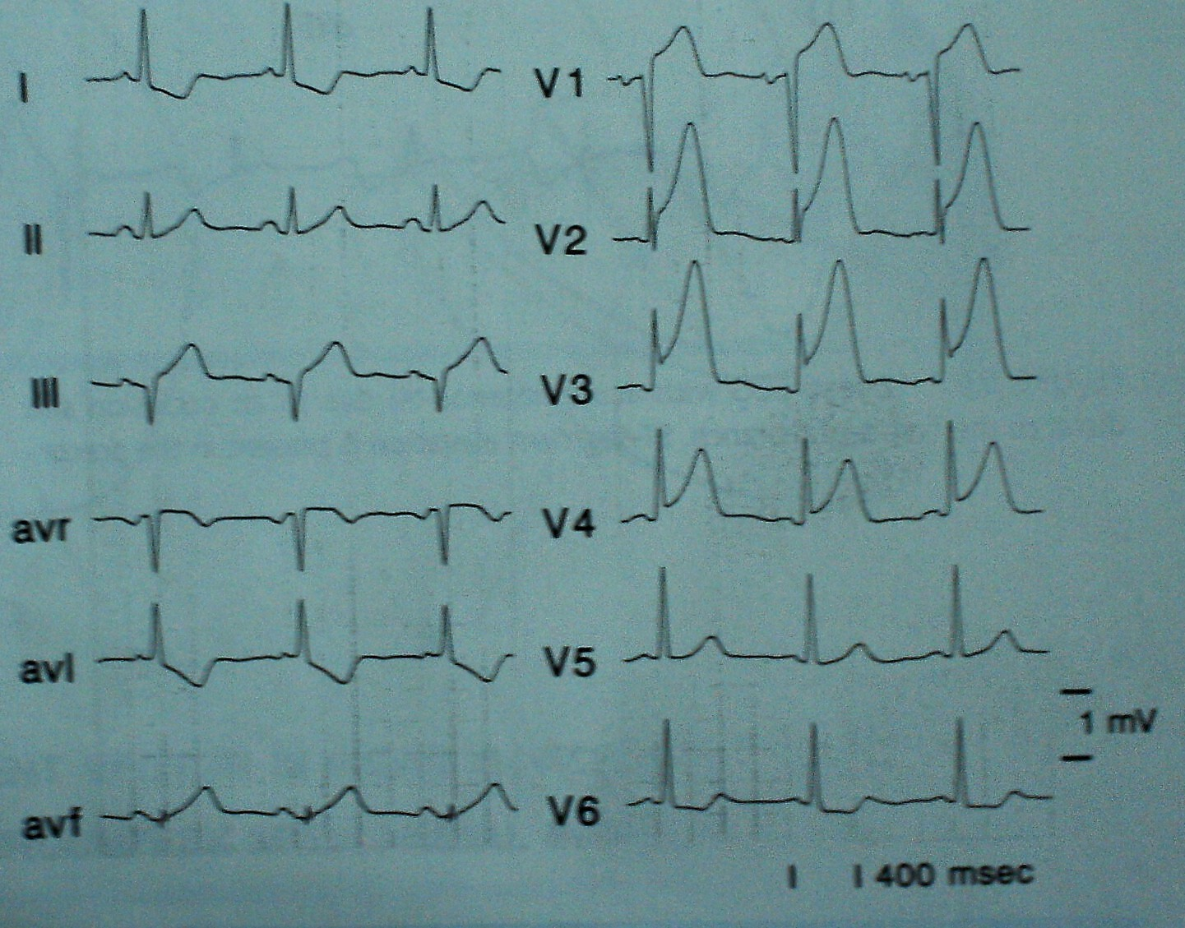

Slide 32
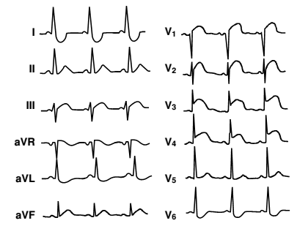
1st Diagonal not involved (Dominance of septal area)-Proximal to S1

Slide 33
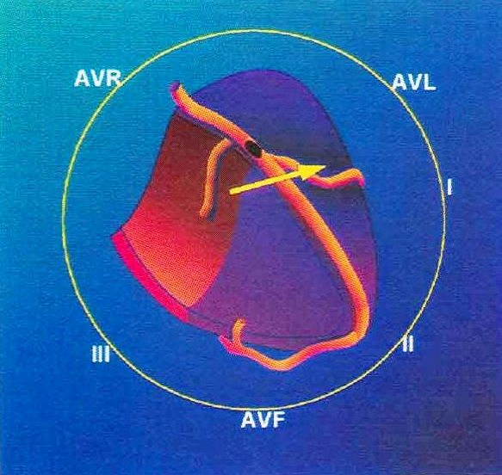
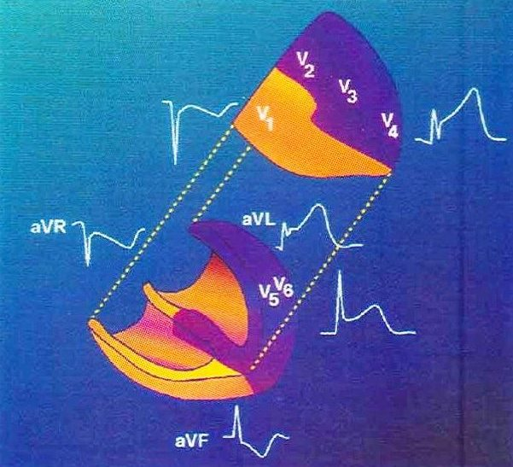
First septal branch not included (Dominance of Lateral area) – Prox to D1
Injury vector is directed anteriorly, upward, and somewhat to the left
Notes:
In this case, the injury vectoris directed anteriorly, upward, and somewhat
to the left

Slide 34
First septal branch not included (Dominance of Lateral area) – Prox to D1
ST elevation lead AVL & lead I
Q left lateral leads
ST depression in Lead III > Lead II
ST depression in (III + aVF) ≥ 2.5 mm

Slide 35
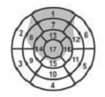
First septal branch not included (Dominance of Lateral area) – Prox to D1

Slide 36
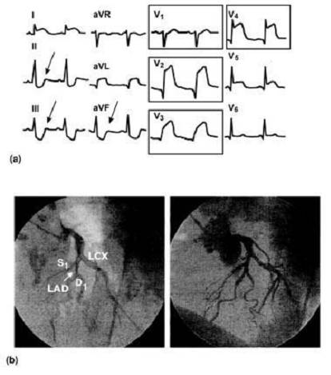
First septal branch not included (Dominance of Lateral area) – Prox to D1

Slide 37
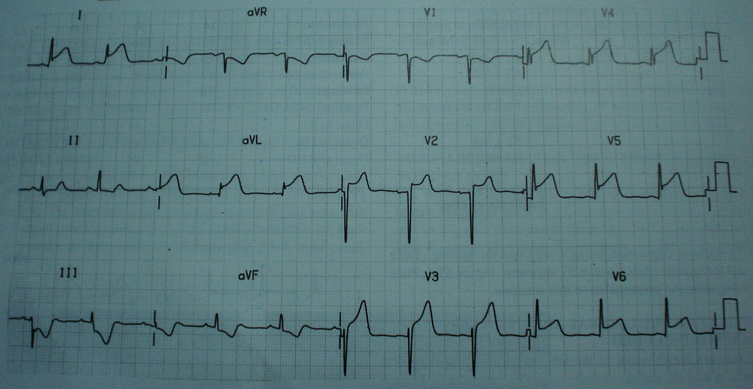

Slide 38
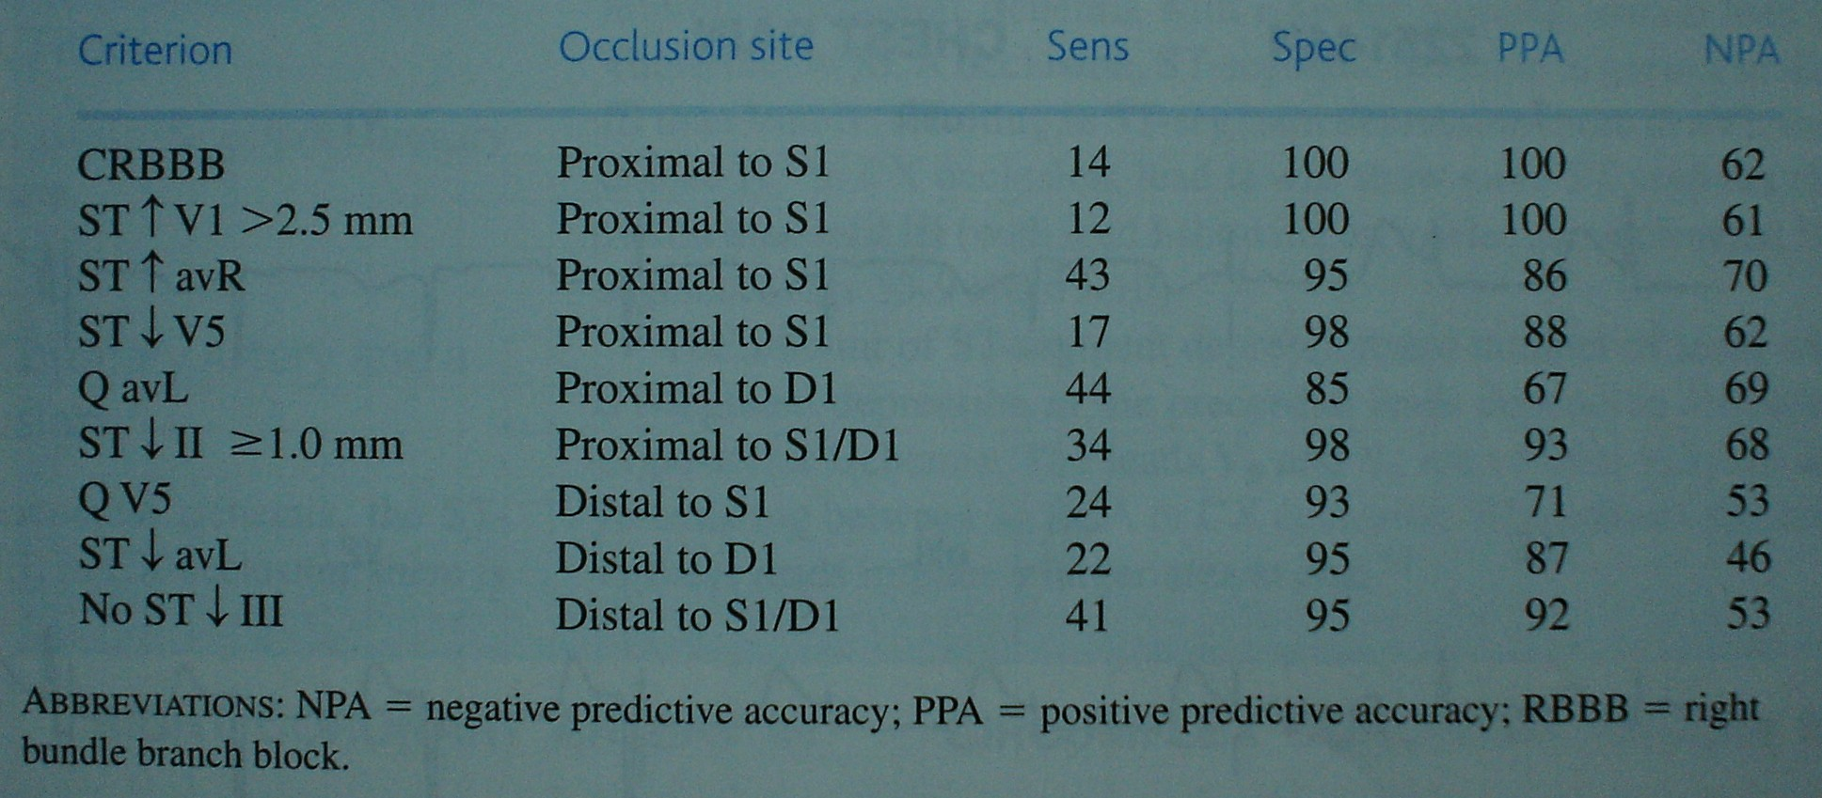
ECG criteria to identify site of occlusion in the LAD

Slide 39
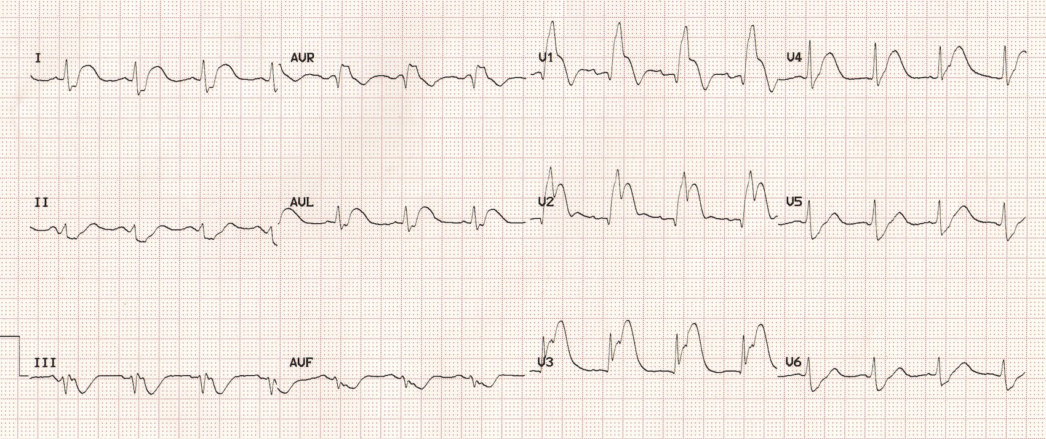
New QRBBB in V1 is a specific but insensitive marker of proX LAD occlusion

Slide 40
Selective occlusion of the D1branch
Area affected -Mid-low anterior wall and part of the mid- and often low-lateral wall
Injury vector is directed upward, to the left and forward
STE in I, aVL and precordial leads V2−V6 (Variable)
ST depression in II, III, and VF (III >II)

Slide 41
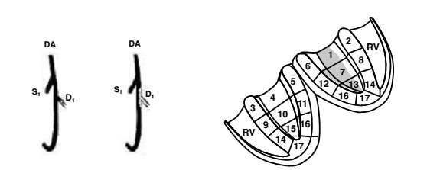
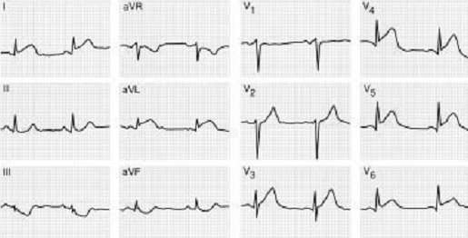
Selective occlusion of the D1branch

Slide 42
Selective occlusion of the S1branch
Septal wall with occasionally certain extension toward the anterior wall
Injury vector directed anteriorly, upward, and to the right
STE in V1,V2, and aVR
ST depression in II, III, aVF (II>III), and V6
No ST elevation in aVL

Slide 43
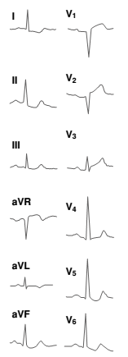
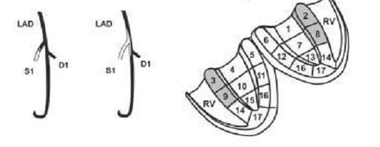
Selective occlusion of the S1branch

Slide 44
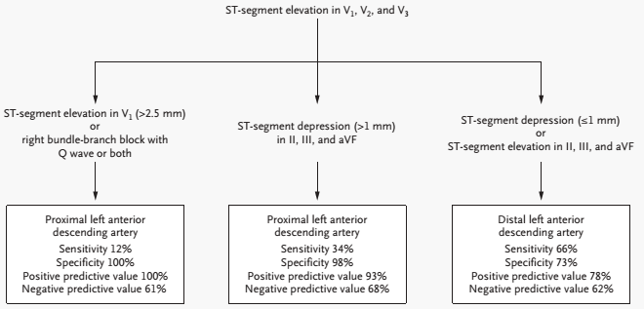
Algorithm for ECG Identification of the Infarct-Related Artery in AW-STEMI
Engelen DJ, Gorgels AP, Cheriex EC et al J Am Coll Cardiol 1999; 34:389-95

Slide 45
IWMI

Slide 46
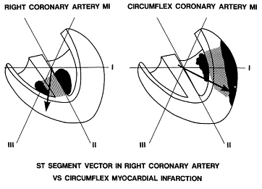
Injury vector in RCA and LCX

Slide 47
Right coronary
Circumflex coronary
Inferoseptal ischemia | Inferoposterolateral ischemia
Vector directed to III | Directed to II
STE III > II | STE II > III
ST depression in aVL>I | STE I or aVL or both
RV can be involved | True PWMI can occur
V5 and V6 are of little value in differentiating between RCA or Cx occlusion. STE in these leads implies a larger area at risk

Slide 48
Occlusion of the RCA
ST elevation in III > II
ST depression in I and aVL - aVL > I
ST depression in the right precordial leads is smaller than STE in inferior leads
When occlusion is proximal to RV branches ST E in V1 > V3 V4

Slide 49
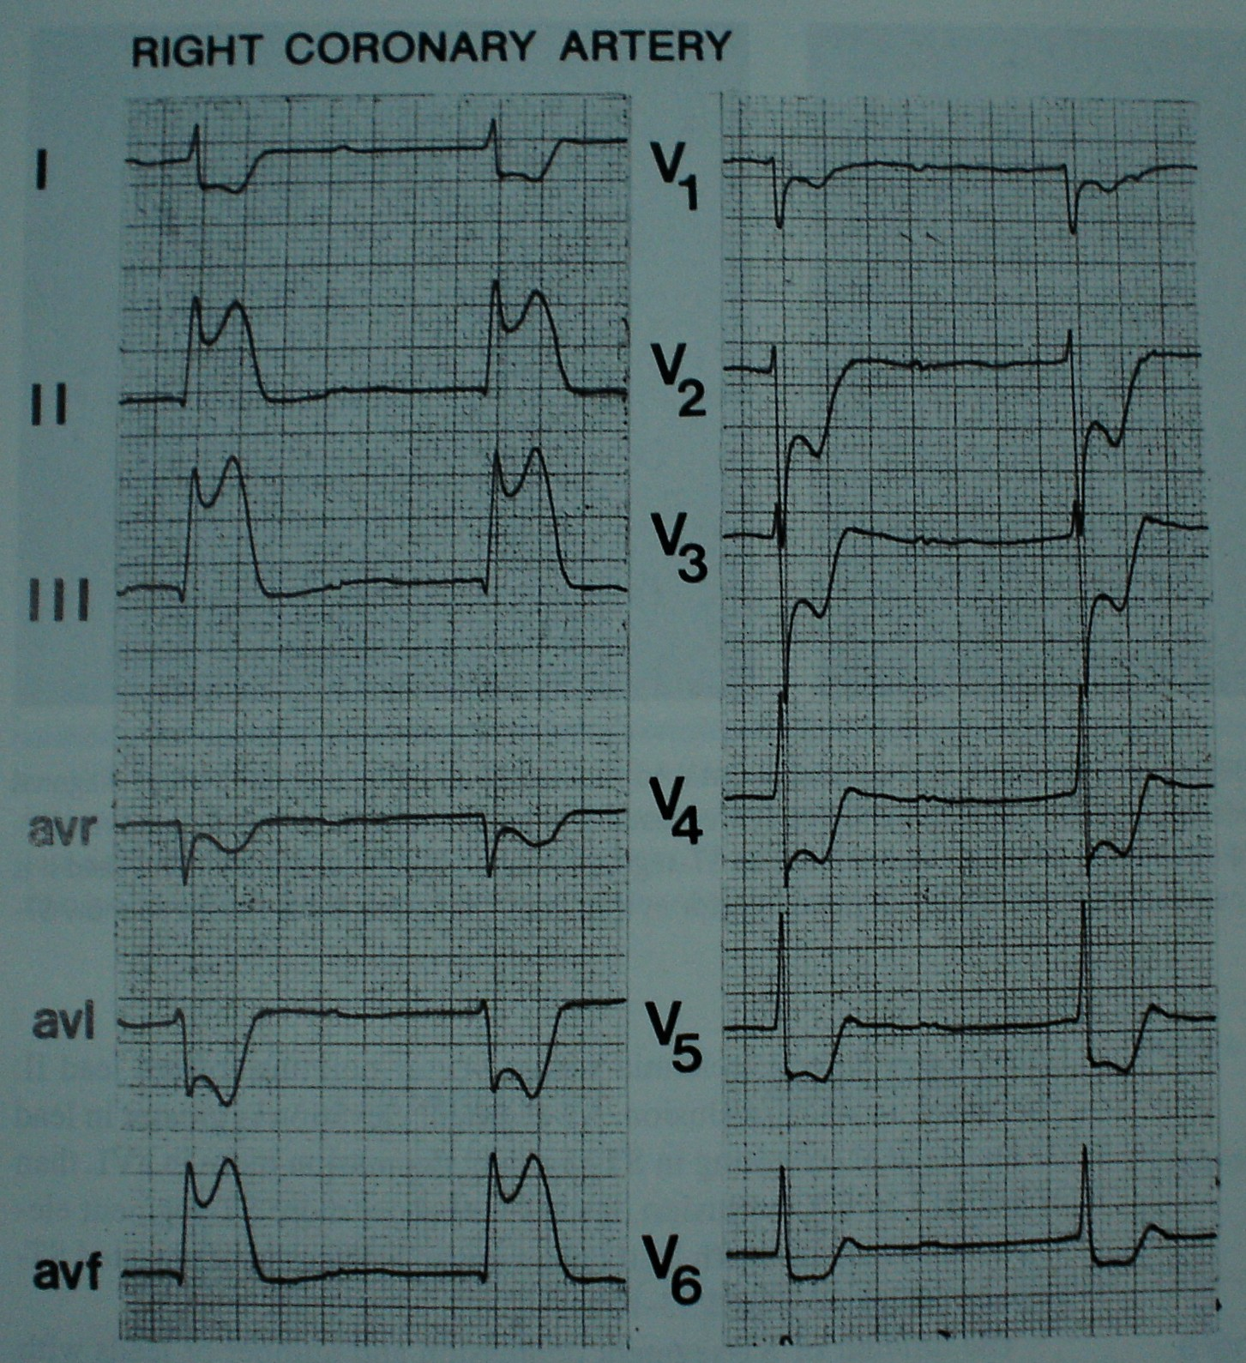

Slide 50
Occlusion of the RCA (Contd..)
When RCA is dominant, STE is seen in V5 and V6 (Local injury vector)
Involvement of posterior wall
RCA very dominant or super dominant - STE elevation ≥ 2 mm in V5-V6 and ST depression in I and aVL
Eskola et al. 2004

Slide 51
Occlusion of the LCX
ST- elevation in II ≥ III
ST elevation in I and aVL or isoelectric (rarely)
STE in II, III, and aVF is usually smaller than the ST depression in right precordial leads
When LCX is quite dominant - ST depression in aVL, but very rarely in I and STE 4-5 mm in v5-v6
ST depression in aVR - Involvement of either the LCX or the RCA with a large posterolateral (PL) branch
The specificity and sensitivity for lead aVR to predict LCX involvement - 94% and 70%, respectively
Zhang YZ et al . The value of ECG lead aVR
in the differential diagnosis of acute IWMI. Intern Med, 2007; 46: 795–799
Decrease in R-wave amplitude and an increase in S-wave amplitude with an S/R ratio of >1:3 in aVL predict RCA occlusion, whereas an S/R ratio of 1:3 or less predict LCx occlusion
Assali AR et al. Electrocardiographic criteria for
predicting the culprit artery in IWMI. Am J Cardiol, 1999; 84: 87–89

Slide 52
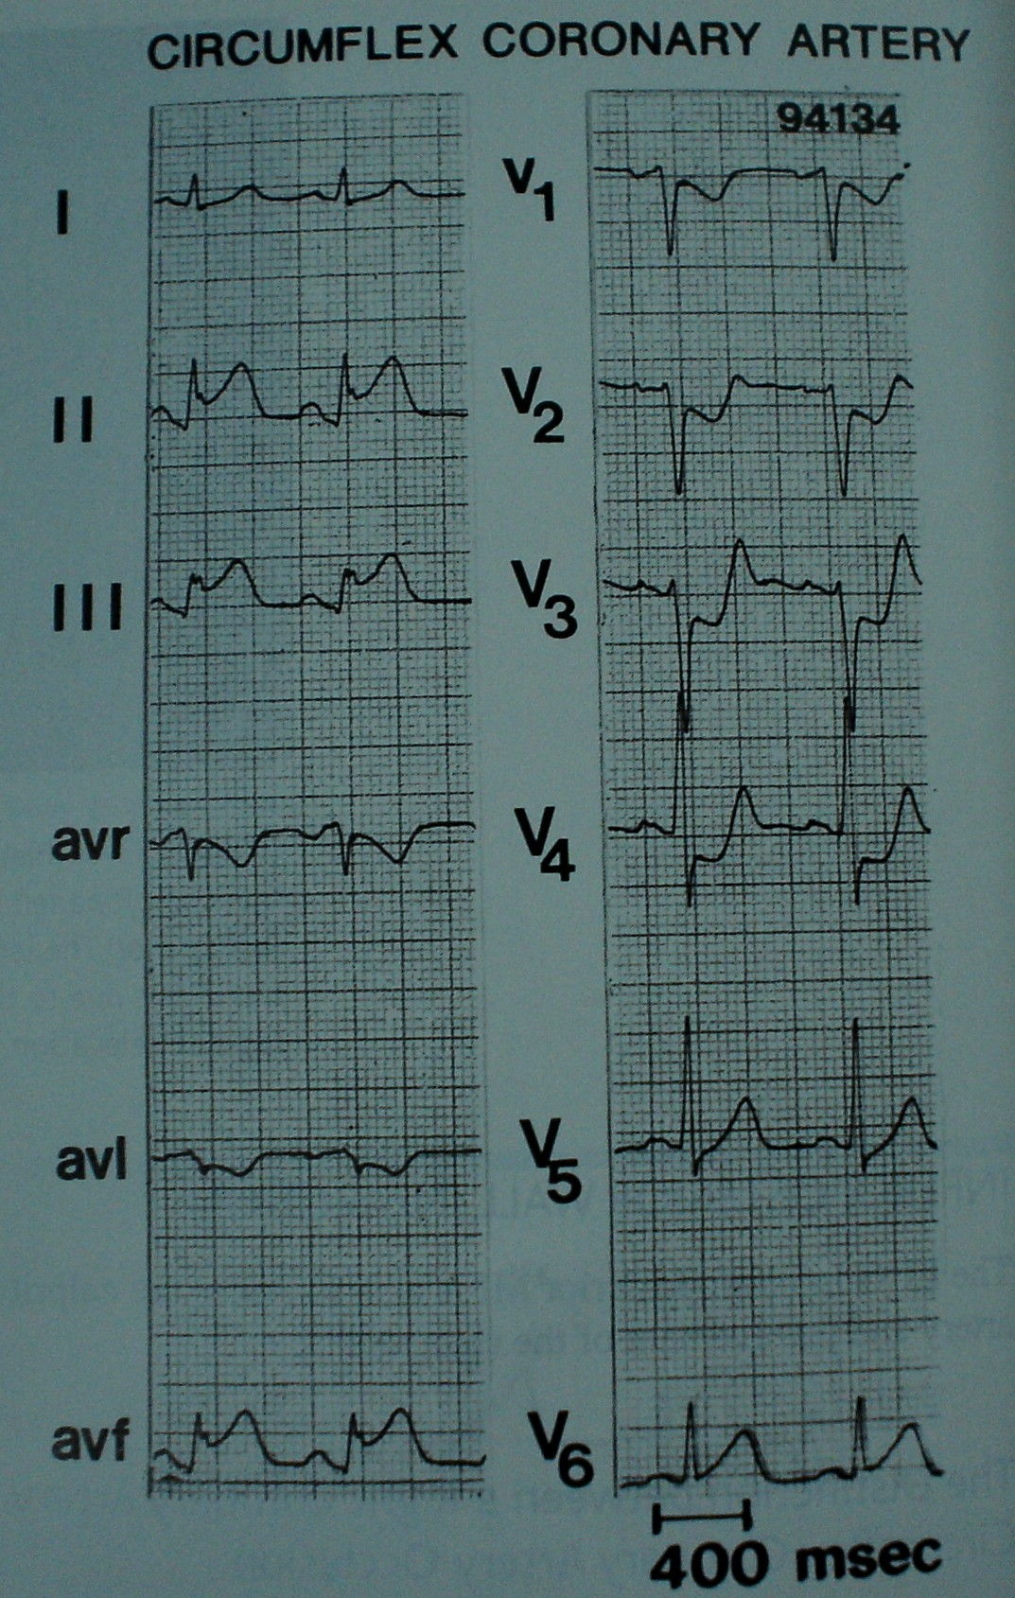
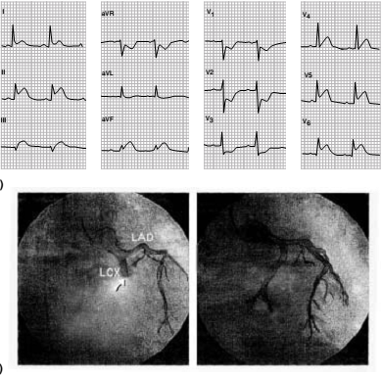

Slide 53
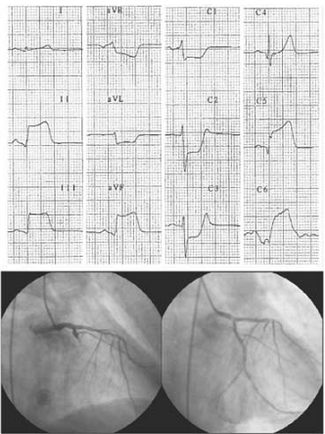
Proximal occlusion of a very dominant LCX

Slide 54
First step:
Assess the ST-segment in lead I
STD
STE
Isoelectric-
Proceed to 2nd step:
RCA
LCX
STE in II, III, aVF
III > II
Proceed to 3rd step:
II > III
Ʃ STD V1-V3
Ʃ STE II, III, aVF
LCX
Fiol M A et al;
Value of electrocardiographic algorithm based on “ups and downs” of ST in assessment of a culprit artery in IWMI
Am J Cardiol, 2004; 94: 709–714
> 1
LCX
< 1
RCA

Slide 55
OM VS D1 occlusion
OM
D1
Injury vector left, posterior, some what upward or downward
STE I, aVL, and V5−6
STE may in II and aVF
Slight STD in V1-V3
Injury vector is directed leftward, but upward and somewhat anteriorly
STE I, aVL, and V5−6
STE in precordial leads
ST-depression II, III, aVF

Slide 56
RVMI

Slide 57
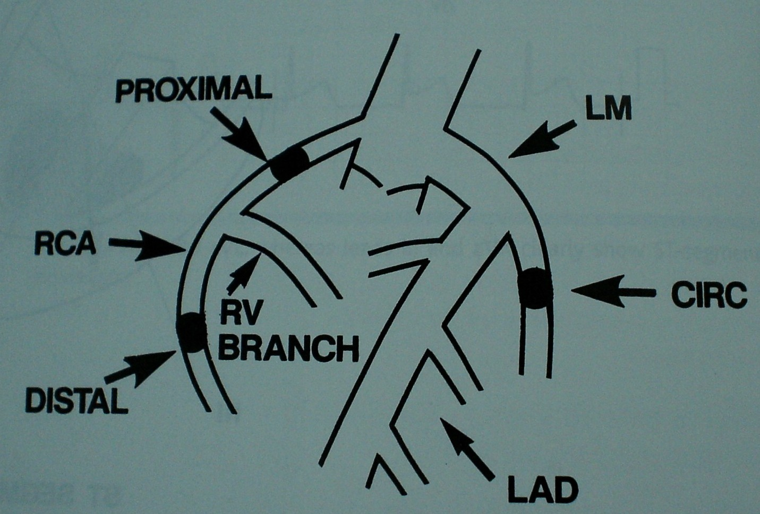
RV infarction
Notes:
Diagnosing RV-involvement in inferior wall infarction is difficult from the
standard 12 leadECG. The reason being that precordial leads overlying the RV
frequently record ST depression due to reciprocal ST segment changes
of ischemia of the posterior wall

Slide 58
RV infarction
STE >1mm V3R and V4R
STE V1 > V2
High degree AV block
Sometimes STE in V1 with STD in V2 (Discordant relationship)

Slide 59
STD in V3
STE in III
Less than 0.5
Proximal RCA
Sens 91%
Spec 91%
0.5 to 1.2
Distal RCA
Sens 84%
Spec 93%
More than 1.2
LCx artery
Sens 84%
Spec 95%
Kosuge M, Kimura K, Ishikawa T et al.
New electrocardiographic criteria for predicting the culprit artery in
inferior wall acute myocardial infarction. Am J Cardiol, 1998; 82: 1318–1322

Slide 60
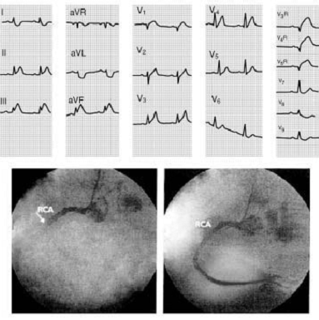
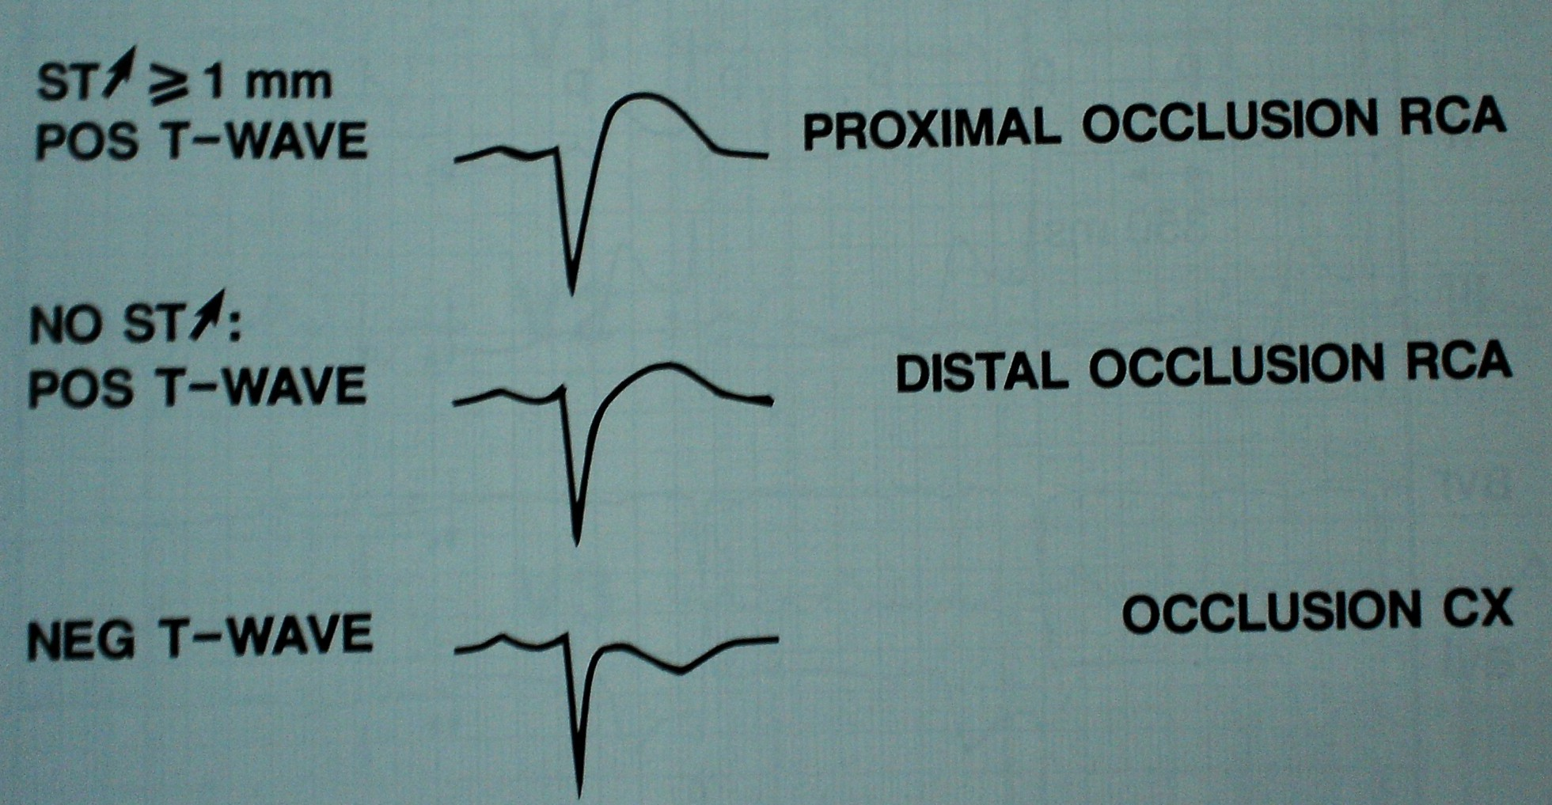
V4R in acute infero posterior MI

Slide 61
STE III>II
STD in I, aVL or both (>1mm)
RCA
Sensitivity 90%
Specificity 71%
PPV 94%
NPV 70%
STE I, aVL, V5 and V6
STD in V1,V2,V3
LCX
Sensitivity 83%
Specificity 96%
PPV 91%
NPV 93%
In addition, STE in V1, V4R, or both
Proximal RCA with RVMI
Sensitivity 79%
Specificity 100%
PPV 100%
NPV 88%
Zimetbaum et Al; NEJM 2003

Slide 62
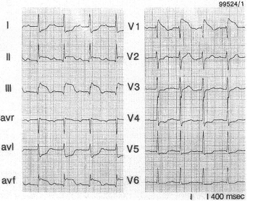
STEMI due to proximal RCA occlusion

Slide 63
STEMI due to RCA occlusion distal to the RV branches

Slide 64
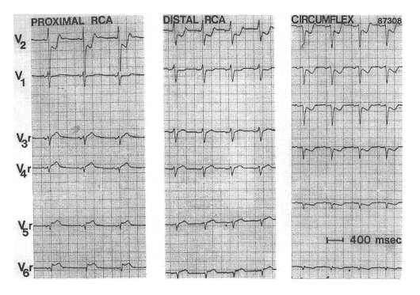

Slide 65
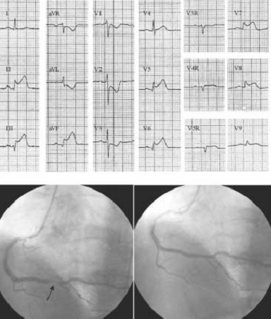
Very dominant RCA occlusion distal to the RV branches

Slide 66
Proximal occlusion of a very dominant LCX

Slide 67
Isolated RVMI
Minor changes in inferior leads, but STE prominent in leads V1 and V2 and right precordial leads (V3R and V4R)
Due to either a small or collaterally filled RCA or an occlusion of an RV branch only

Slide 68
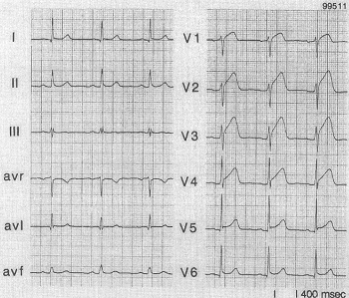

Slide 69
PWMI

Slide 70
Posterior wall involvement
ST depression in the precordial leads
May extend from V1 to V6 and indicate larger MI
Maximal ST depression in V4 – V6 is seen more in three vessel disease and lower LVEF
Can occur both in RCA and Cx artery involvement
Notes:
Isolated ST depression in the precordial leads may present the difficulty to
Differentiate acute CX occlusion, resulting in true posterior wall infarction,
from nonocclusive anterior myocardial ischemia. It has been suggested that in
that situation maximal ST depression in or is predictive for acute CX
occlusion (24-26). Also the recording of qR complexes with ST segment
elevation in leads has been recommended to diagnose a CX occlusion

Slide 71
Posterior wall involvement
In case of LCX occlusion posteriorwall involvement is almost obligatory
Absence of precordial ST depression in inferior wall infarction is therefore strongly suggestive of RCA involvement
Isolated ST depression V1-V3– LCx occlusion with a true PWMI or nonocclusive myocardial ischemia
Max ST depression in V2 and V3 is predictive of LCx
V7 –V9 shows ST elevation even though less amplitude

Slide 72
True PWMI
ST depression in V1, R/S >1, and upright T wave
V1
V9

Slide 73
Left main stem occlusion or triple vessel disease
Marked down sloping ST depression in I, II, and V4 – V6 and STE in aVR
aVR STE occurred more in LMCA than in LAD
V1 STE was less in LMCA than LAD
High mortality rate in those with higher STE in Avr
Yamaji H et al J Am Coll Cardiol 2001;38:1348-1354

Slide 74
Left main stem occlusion or triple vessel disease
Acute LMCA occlusion rare but causes serious hemodynamic deterioration
More commonly, subtotal occlusion occurs with collaterals filling from RCA → presents as Unstable angina
ECG of subtotal occlusion similar to triple vessel disease

Slide 75
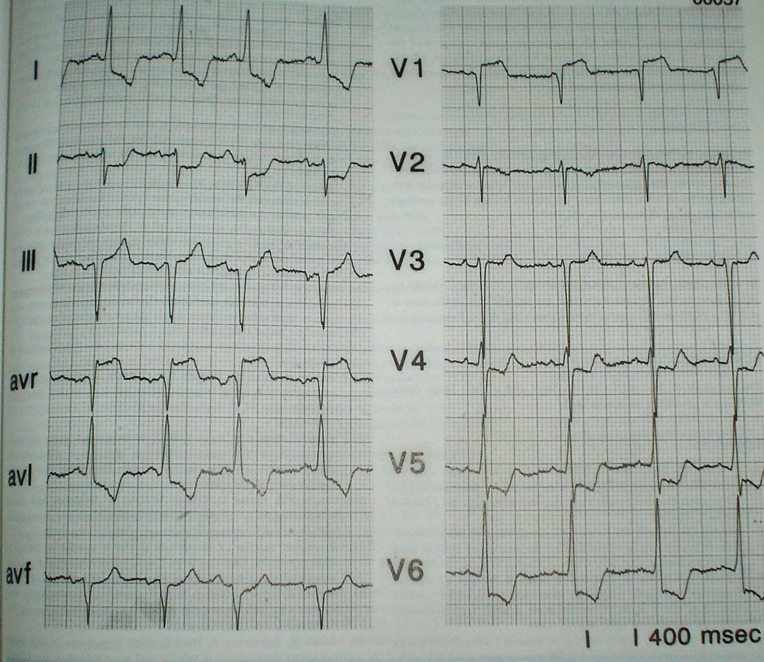

Slide 76
Conduction disturbances

Slide 77
AV conduction disturbances
AV nodal delay and block occurs with proximal RCA involvement, frequently with RVMI
Higher in-hospital morbidity & mortality

Slide 78
Sub AV conduction disturbances
RBBB with or without hemiblock during acute AWMI indicates proximal LAD
BBB or CHB indicates poor prognosis
LAHB in acute IWMI indicates additional LAD disease

Slide 79
Atrial infarction
Signs of atrial MI are seen in PTa segment
PTa segment elevation occurs in I, II, III, V5 or V6 or a depression in precordial leads
Occurs in 10 % of inferoposterior MI
Isolated occurrence is rare
Proximal RCA or Cx

Slide 80
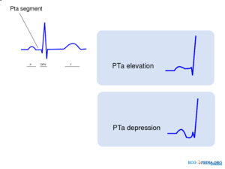

Slide 81
Acute MI : ECG subsets and correlated infarct related artery and mortality
Category | Anatomy of occlusion | 30 Day mortality | 1 Year mortality
Proximal LAD | Proximal to S1 | 19.6 | 25.6
Mid LAD | Proximal to large diagonal but distal to S1 | 9.2 | 12
Distal LAD or diagonal | Distal to large diagonal or diagonal itself | 6.8 | 10.2
Moderate to large inferior | Proximal RCA or LCX | 6.4 | 8.4
Small inferior | Distal RCA or LCX branched | 4.5 | 6.7
Gusto I cohort population Topol EJ; ed 1998
Notes:
Gusto I cohort population Topol EJ; ed 1998

Slide 82
Limitations
Assessment of the site of occlusion of coronary vessel by ECG is most reliable in case of 1st MI
Impaired
Multivessel disease
Collateral circulation
When ventricular activation is prolonged as in
LVH
Preexistent LBBB
Preexcitation
Paced rhythm

